Slide 1
Chapter 14
Poject management Techniques

Slide 2
CoCoMo
1.05
PM = 2.4(KDSI)
Where PM is effort in people-months.
So, if 1,000 instructions are required, then:
PM = 2.4(1,000)
= 2.692 (or nearly three people-months)
1.05

Slide 3
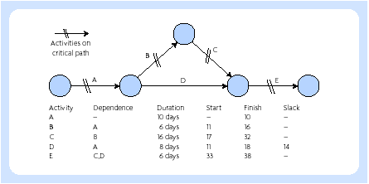
PERT charts
Project control – the network and critical path

Slide 4
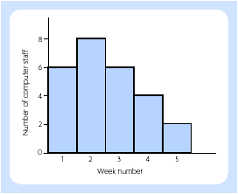
Project control
Resource schedule

Slide 5
Project control - packages
• Reallocating staff
• Unexpected staff leave
• Machine breakdown
• Latest starting date
• Earliest starting date
• By department
• By resource
• By responsibility
• Prolonging an activity
• Reducing resources applied to it
• Adding new activities

Slide 6
Project control - monitoring
Compare the time schedule with the actual progress made
Compare the cost schedule with the actual costs
Maintain the involvement of users and clients
Detect problem areas
Re-plan and reschedule as a result
Provide a historical record, which can be used for future project planning

Slide 7
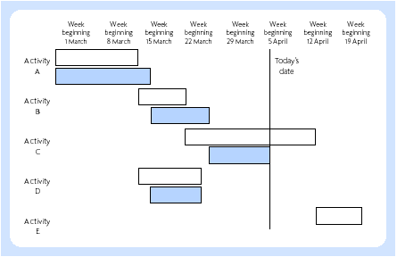
Gantt chart

